Slide 1
Git Recap

Slide 2

What is Git?
Git is an open source distributed version control system

Slide 3
What’s Version Control?
1

Slide 4
What’s Version Control?
Track changes on text files / source files for you
Unlimited Undo / Redo
Time Travel
Collaborative development environment
Compare and Blame
What changed
When it changed
Why it changed
Who changed it
Notes:
What are text files? What is source file?
Give me an example? Are you going to write source file?
Python file, Ansible file, docker files etc.
do you have a luxury to lose the code you wrote??
They’re paying for that code and every code a has a price tag.
Jira, every ticket has a price on it. how many people worked on that ticket. how many hours. So feature
What is undo who knows to do undo?
Word document example.
Undo Redo example.
Show undo button on word document.
Many people works collaboratively.
To make it happen we need a system.
What is Codebase?

Slide 5
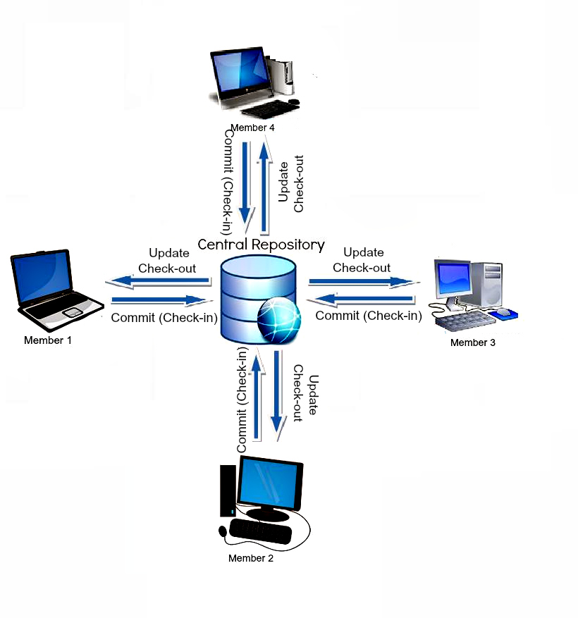
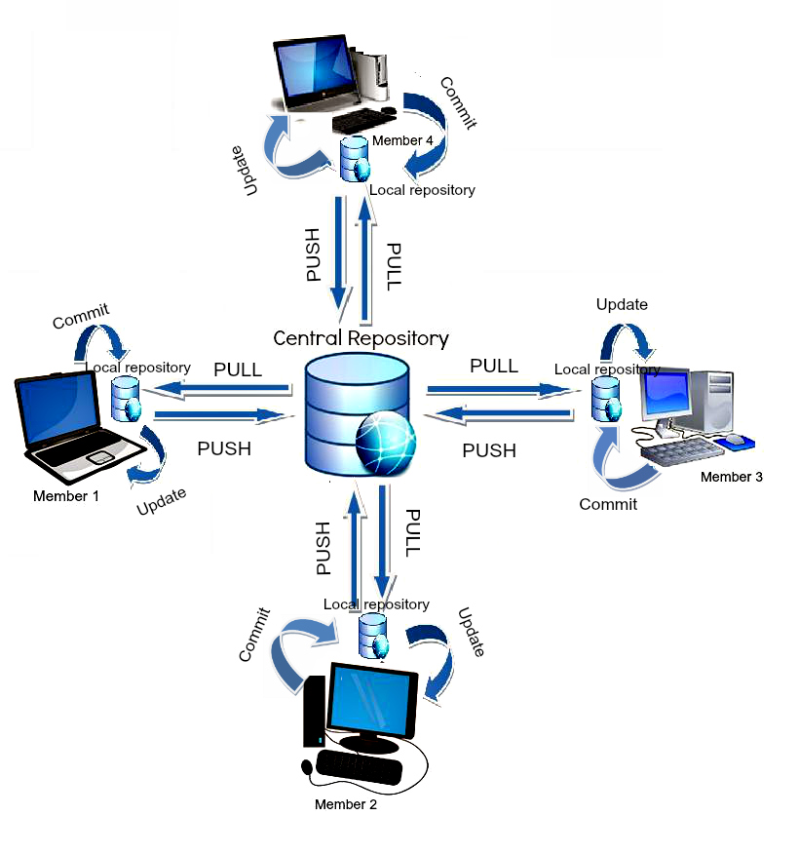
Version Control Systems
Centralized
Distributed
You need to be connected to the server You can work while offline

Slide 6
What’s Version Control?
Version Control Systems (VCS)
Tracks and records changes to files over time
Can track any type of file, but most commonly used for code
Contains extra information such as date, author, and a message explaining the change

Slide 7
What’s Version Control?
Benefits of Version Control Systems (VCS)
Can retrieve previous version of files at any time
Retrieve files that were accidentally deleted
Can be used locally, or collaboratively with others

Slide 8
What is Git?
2

Slide 9
What is Git?
Git is a software
Content Tracker
Distributed Version Control System (VCS)
Linus Torvalds
Notes:
Fundamental part of your everyday life.
You’re going to use everyday. It’s very important to understand the concept.
Interview questions you’ll be asked a lot about this subject.
Daily use. if you don’t know how to use it it’s going to create a problem.
You write your code, you can store your code in your computer right now.
In IT environment, your computer is not reliable, you can drop your computer, you can lose it,
You need to make a lot of copies and backup.
How would you do it? If you want to save your files, would you put version numbers? Date? etc.
version 1, version 2, version 3.
You will not need versioning file anymore.
But at the end of the day you need to store your code in somewhere safe, which is cloud.
The name of the cloud might be different Github, Bitbucket, Gitlab etc.
But the application used in every case is Git.

Slide 10
Why do we need Git?
Backup/Archive/Versioning/History
Undo Changes
Comparing
Collaboration and Teamwork
Code Review
Blame
Notes:
Code: Money
Compare: previous version of the code
Collaboration & teamwork:
Bad guy :) Code reviews. Team mate/Team lead. They can improve or correct the code.
Engineer making $200K, but can cause problem worth millions of dollars.
Database.
Storing the data as files.
Git stores the data as objects.
SHA1
Collaboration - Testers, Developers, DevOps Engineer
Communication will be on Git
Pipeline CI/CD : Test automation to CI/CD is impossible
Early testing : Fast feedback. Testing is a matter
Learning : Gateaway to more advanced …
Bash scripting, pipeline integration etc.

Slide 11
Git Basics
Local Git
Distributed so that connectivity doesn’t block work
Easy so that learning its commands can happen progressively
Distributed Git
Team-centric so that collaboration happens naturally

Slide 12



Git Basics
Backup
In any case if your remote server crashes, a backup is available in your local servers.
Remote copy
Local copy 1
Local copy 2
Local copy 3

Slide 13

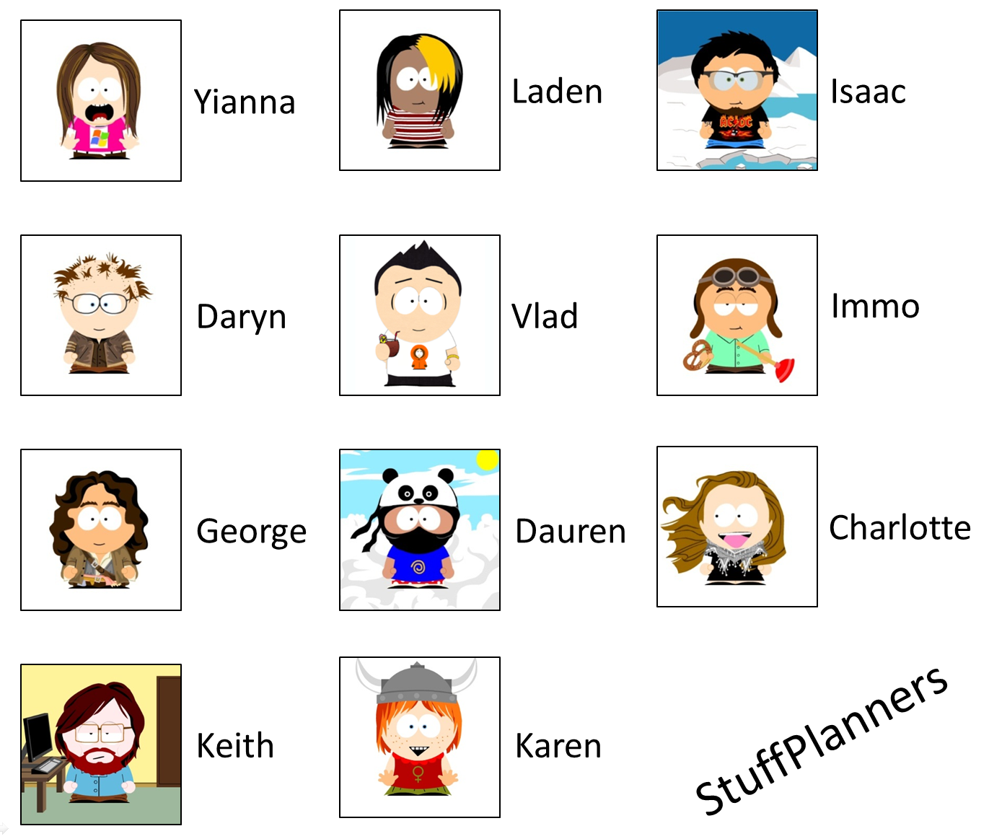
Git Basics
Collaboration
Task 1
+
Task 2
+
Task 2
Combined Tasks

Slide 14
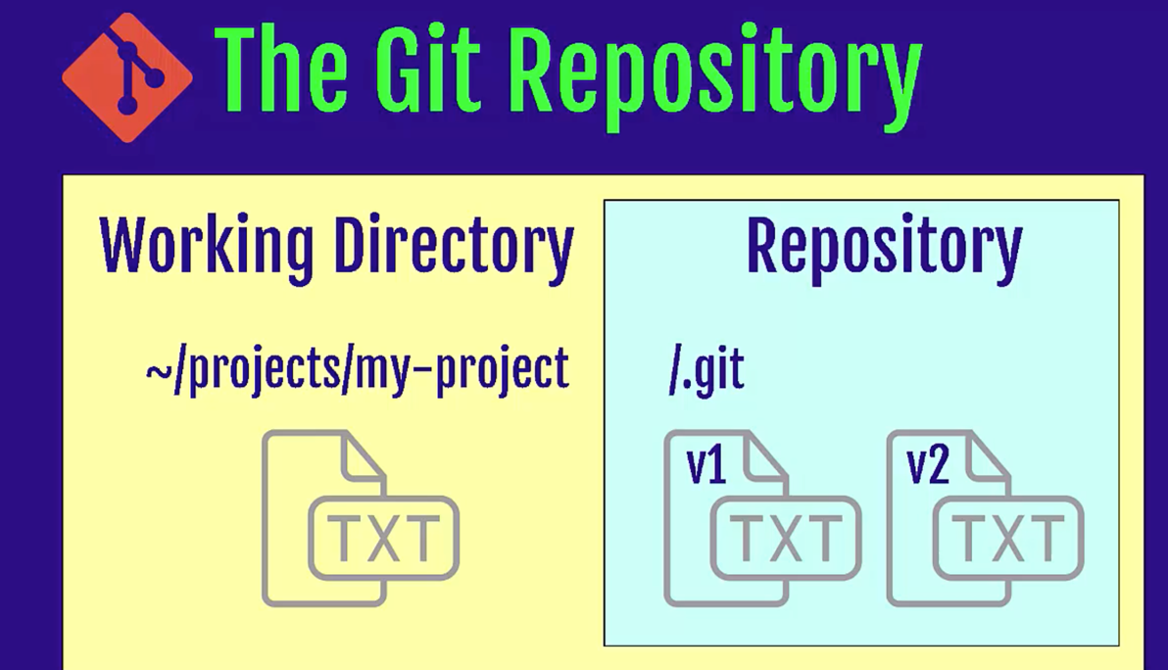
Git Repository
What is a repository
A directory or storage space where your projects can live.
Local Repository
Remote Repository
Notes:
Let’s start getting our hands dirty.
Step by step.
Try to do whatever I do.
What is CLI?
Why do we use CLI over GUI?
Some CLI commands. You’ll see more commands tomorrow. It’s a demo only.
Repository is not only your files but also all the information about the changes made on your project files.
Repo can live in your computer or remotely on hosted server (cloud)
Let’s see what it looks like?
Git doesn’t care about working directory a lot.
Because it can be changed immediately.
Desktop create a folder named projects
capital-one-project
check git is installed correctly
git config --global user.name “Name”
git config --global user.email
git init

Slide 15
Git Repository
Let’s check if you have git in your computer
git --version t
git needs your identity to mark/label changes / editor
git config --global user.name “Your Name” t
git config --global user.email “Your Email” t
git config --global core.editor “vim” t
git config --list t
Notes:
For different repositories if you like to define different username or email use the command without global option.
git config user.name

Slide 16
Git Repository
to create a new local repo
git init t
to see the commands
git helpt
to see the status of your repo
git status t
Notes:
Let’s see what it looks like?
Let’s start playing with Git.
Windows powershell / gitbash
Mac terminal
Let’s create a folder on Desktop for convenience. my-projects
mkdir my-projects
What happened
to see what happened let’s go to project folder
It’s nothing but so many folders and files.
hidden files
To delete your repository, just delete the folder.

Slide 17
Git Repository
to create a new remote repo and connect it with your local repo (after you create a remote repo on Github/Bitbucket etc.)
git clone address t
Notes:
We’re going to see remote repo operations on the next session.
just fyi.

Slide 18
Workflow
3

Slide 19


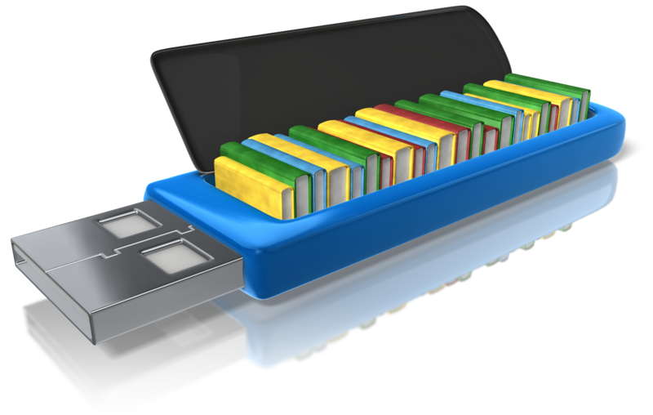
Workflow
Working Directory Staging Area (Index) Repository
Where you work. Create new files, edit files delete files etc.
Before taking a snapshot, you’re taking the files to a stage. Ready files to be committed.
Committed snapshots of your project will be stored here with a full version history.
Notes:
It’s like a shopping cart or a rocket launch.
Until you buy the items are not yours.
go to register and pay then it’s yours, repository is your refrigerator or pantry.

Slide 20
File Stages
Committed
Unmodified changes from the last commit snapshot
Modified
Changes made to files since last commit snapshot
Staged
Changes marked to be added into the next commit snapshot

Slide 21
Track a new file
let’s create a new file in our project folder
touch file1.txt t
let’s edit this file
vim file1.txt t
let’s check the status of our project
git status t

Slide 22
Git
Stage modified files & commit changes

Slide 23
Create a new file
Working Directory Staging Area (Index) Repository
resume.txt
untracked file

Slide 24
Track/stage a file
Working Directory Staging Area (Index) Repository
resume.txt
resume.txt
git add

Slide 25
Stage files options
stage one file
git add filename t
stage all files (new, modified)
git add . t
stage all changes
git add -A t
stage modified and deleted files only
git add -u t

Slide 26
Commit
Working Directory Staging Area (Index) Repository
resume.txt
resume.txt
resume.txt
git commit -m

Slide 27
Commit
Working Directory Staging Area (Index) Repository
resume.txt
resume.txt
resume.txt
git commit -m
git log t
Master

Slide 28
Commit
Commit the files on the stage
git commit -m ”message” t
Add and commit all tracked files
git commit -am ”message” t
amend commit message
git commit --ammend t
Notes:
Commit often
Write clear commit messages

Slide 29
Remove from stage
Working Directory Staging Area (Index) Repository
resume.txt
new_file.txt
resume.txt
new_file.txt
git rm --cached
git restore --staged

Slide 30
Checkout from Repo
Working Directory Staging Area (Index) Repository
resume.txt
new_file.txt
resume.txt
new-file.txt
resume.txt
new-file.txt
git checkout

Slide 31
Git
will talk about later
Local Machine
GitHub
Working directory
Staging area (index)
Git repository
Remote Git repository
git add
git commit
git checkout
Notes:
Let’s start with cloning.
Let’s create a new repo and put a new file on it. Do our first commit.
mkdir gitprojects
499 cd gitprojects/
500 git clone https://github.com/clarusway/labb.git
501 ls
502 git ls
503 ls
504 cd labb
505 ls
506 vim file2.txt
507 git status
508 git add .
509 git commit -m "mee"
510 git s
511 git push origin master
Secondly give them the link of your code and show fork. change it.
Then show them to clone again. remote to remote and then clone.
Scenario: git clone, change the file on remote, git status, git fetch, git merge
then do the same thing with git pull.
change 1 file and try to push before pull see the problem. git pull
Visual representation
Create a commit and push
create a branch and push
local: merge the branch
push
git commit
git commit
git push origin master
git pull
Fetched 0 commits on master.
Already up-to-date.
git fetch
Fetched 0 commits on master.
git branch eric
git push
Everything up-to-date.
git checkout eric
git commit
git commit
git push origin eric
git checkout master
git merge eric
You have performed a fast-forward merge.
git push origin master
Remote visual representation:
git push origin master
Push rejected. Non fast-forward. Try pulling first
git pull
Fetched 0 commits on master.
Fetched 1 commits on feature.
Fast-forwarded to origin/feature.
git commit
git commit
git push origin feature
git checkout master
git merge feature
git push

Slide 32

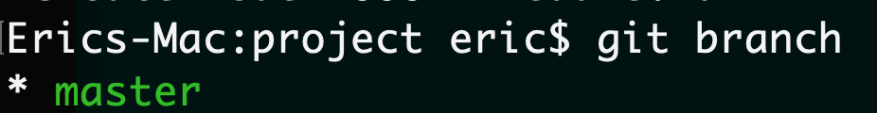
Branches
Production of the project lives on master/main branch
Branches are reference to a commit
Notes:
Here's an example of how Git branches are useful. Let's say you need to work on a new feature for a website. You create a new branch and start working. You haven't finished your new feature, but you get a request to make a rush change that needs to go live on the site today. You switch back to the master branch, make the change, and push it live. Then you can switch back to your new feature branch and finish your work. When you're done, you merge the new feature branch into the master branch, and both the new feature and rush change are kept!
Why do we use branches? Only the final work should be on master branch. All the work we do should be on seperate branches until it’s ready.

Slide 33
Branches
to see local branches
git branch t
to see remote branches
git branch -r t
to see all branches
git branch -a t

Slide 34
Creating/switching branches
create a new branch
git branch Branch name t
switch to a branch
git checkout Branch name t
create a new branch and switch to that branch
git checkout -b Branch name t
Notes:
http://git-school.github.io/visualizing-git/
Let’s practice visually.
Scenario 1:
I have master branch and creating a new branch and do some experiment on it. but i didn’t like it and i want to go back to master. And delete eric branch since I wont use it what happens? when i do new commit where it goes?
git commit
git commit
git checkout -b eric
git commit
git commit
git commit
git checkout master
git branch -d eric
git commit
Scenario 2:
We created a new branch and we liked the changes. we want to merge
git commit
git commit
git checkout -b eric
git commit
git commit
git commit
git checkout master
git merge eric
You have performed a fast-forward merge.

Slide 35
Deleting branches
delete a local branch
git branch -d Branch name t
git branch -D Branch name t
Notes:
The -d option only deletes the branch if it has already been merged. The -D option is a shortcut for --delete --force, which deletes the branch irrespective of its merged status.
Visualizing Git- Show branches
Scenario1: go back to a commit and create a new branch from there.
git checkout 551c4bd
git checkout -b raymon
git commit
git commit
git commit
git commit
git checkout master
git commit
git commit
git merge raymon
git checkout eric
git branch -d raymon
git checkout master
git commit
Scenario2: delete the branch before merging with -d (Do it on your computer not visually)
it will give you an error.
Once you’re done with the feature you can merge back into master

Slide 36
Fast forward merge
Fast forward merge is possible when there are no further commits in the receiving branch after the commit where feature branch was created
HEAD
master
Root
commit
feature-1
Time

Slide 37
Fast forward merge
git merge <feature-branch>
HEAD
Root
commit
master
feature-1
Time

Slide 38
3-way merge
HEAD
master
Root
commit
Ancestor
feature-1
Time

Slide 39
3-way merge
HEAD
master
Merge commit
Root
commit
Ancestor
feature-1
Time

Slide 40
Merge Conflicts
Same files were edited in both branches
HEAD
master
Root
commit
Ancestor
feature-1
Time

Slide 41
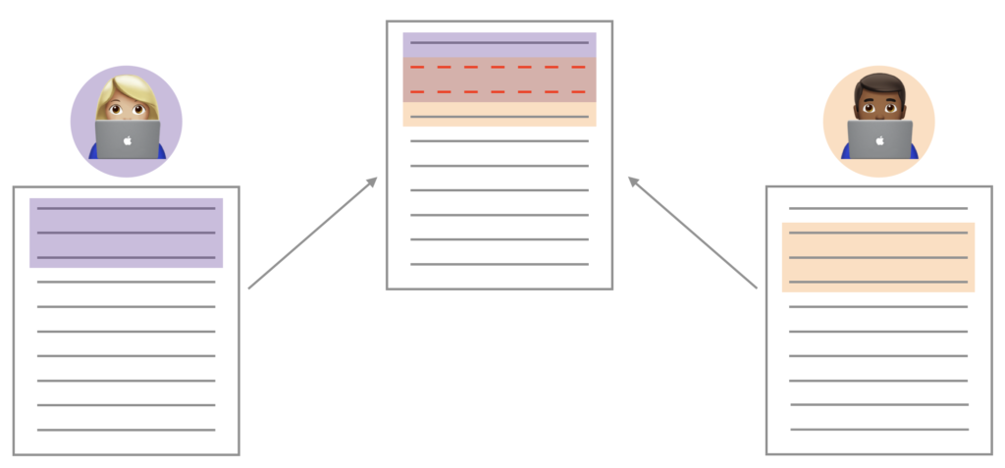
Github - Merge Conflict
Merge conflicts happen when you merge branches that have competing commits, and Git needs your help to decide which changes to incorporate in the final merge.
Notes:
Pull Request ile ilgili senaryo.
Live representation.
remote origin/upstream -
Merge, rebase, conflicts
Cherry pick

Slide 42

Github - Remote Repository
Git
GitHub
&
Distributed
version-control system
Repository hosting service

Slide 43
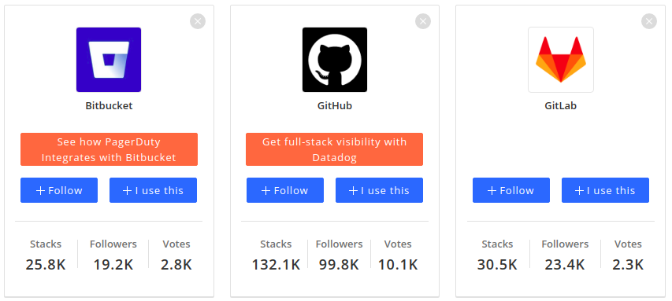
Github - Remote Repository

Slide 44
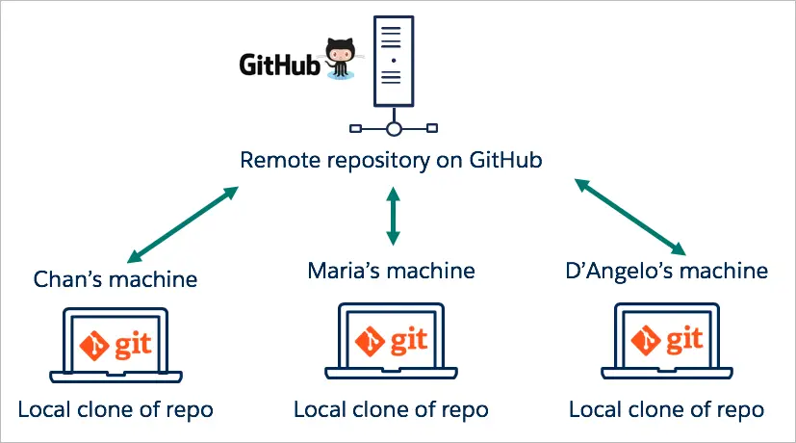
Github - Remote Repository
(default name - origin)

Slide 45
Github - Remote Repository
Act of copying a repository from remote server to your local machine is called cloning
Cloning allows team to work together
Downloading commits from others : fetch, merge
Downloading commits from others : pull (fetch + merge)
Uploading your commits (local changes) to remote : push
Notes:
Let’s start with cloning.
Let’s create a new repo and put a new file on it. Do our first commit.
mkdir gitprojects
499 cd gitprojects/
500 git clone https://github.com/clarusway/labb.git
501 ls
502 git ls
503 ls
504 cd labb
505 ls
506 vim file2.txt
507 git status
508 git add .
509 git commit -m "mee"
510 git s
511 git push origin master
Secondly give them the link of your code and show fork. change it.
Then show them to clone again. remote to remote and then clone.
Scenario: git clone, change the file on remote, git status, git fetch, git merge
then do the same thing with git pull.
change 1 file and try to push before pull see the problem. git pull
Visual representation
Create a commit and push
create a branch and push
local: merge the branch
push
git commit
git commit
git push origin master
git pull
Fetched 0 commits on master.
Already up-to-date.
git fetch
Fetched 0 commits on master.
git branch eric
git push
Everything up-to-date.
git checkout eric
git commit
git commit
git push origin eric
git checkout master
git merge eric
You have performed a fast-forward merge.
git push origin master
Remote visual representation:
git push origin master
Push rejected. Non fast-forward. Try pulling first
git pull
Fetched 0 commits on master.
Fetched 1 commits on feature.
Fast-forwarded to origin/feature.
git commit
git commit
git push origin feature
git checkout master
git merge feature
git push

Slide 46
Connecting your local with remote
connect to remote repo
git remote add origin Repo address t
origin = alias for your repo address
first push
git push -u origin master t
remove remote origin
git remote rm origin t
Notes:
Everybody has a Github account right?
Origin is an alias to the remote repository. We say origin so we won't have to write out the URL of the remote repo every time in the future. While origin is the name most people use, you can name it something else.
-u is short for --set-upstream and adds an upstream (tracking) reference so in the future, Git will remember where we want to push to and pull from. That will allow us to use git pull or git push without having to specify extra arguments.
If this is the first time pushing to the remote server, you should be asked to login with your username and password.

Slide 47
Github - Remote Repository
Working directory
Staging area (index)
Git repository
Remote Git repository
git add
git commit
git push
git checkout
git fetch
git pull
Notes:
Let’s start with cloning.
Let’s create a new repo and put a new file on it. Do our first commit.
mkdir gitprojects
499 cd gitprojects/
500 git clone https://github.com/clarusway/labb.git
501 ls
502 git ls
503 ls
504 cd labb
505 ls
506 vim file2.txt
507 git status
508 git add .
509 git commit -m "mee"
510 git s
511 git push origin master
Secondly give them the link of your code and show fork. change it.
Then show them to clone again. remote to remote and then clone.
Scenario: git clone, change the file on remote, git status, git fetch, git merge
then do the same thing with git pull.
change 1 file and try to push before pull see the problem. git pull
Visual representation
Create a commit and push
create a branch and push
local: merge the branch
push
git commit
git commit
git push origin master
git pull
Fetched 0 commits on master.
Already up-to-date.
git fetch
Fetched 0 commits on master.
git branch eric
git push
Everything up-to-date.
git checkout eric
git commit
git commit
git push origin eric
git checkout master
git merge eric
You have performed a fast-forward merge.
git push origin master
Remote visual representation:
git push origin master
Push rejected. Non fast-forward. Try pulling first
git pull
Fetched 0 commits on master.
Fetched 1 commits on feature.
Fast-forwarded to origin/feature.
git commit
git commit
git push origin feature
git checkout master
git merge feature
git push

Slide 48
Github - Pull Request
Github’s feature not Git’s feature
It allows you to contribute to other projects
Notes:
Pull Request ile ilgili senaryo.
Live representation.
remote origin/upstream -
Merge, rebase, conflicts
Cherry pick

Slide 49
Github - Pull Request
Pull Requests (PR) let you tell others about changes you've pushed to a branch in a repository on GitHub
You create a pull request to propose and collaborate on changes to a repository. These changes are proposed in a branch, which ensures that the master branch only contains finished and approved work.
Notes:
Pull Request ile ilgili senaryo.
Live representation.
remote origin/upstream -
Merge, rebase, conflicts
Cherry pick

Slide 50
How collaborators communicate?
feature-2
Mike
master
Jane
feature-1
Time

Slide 51
Why “pull” request?
Remote
Mike
Jane
Tom
Ok. Let me pull and check it!
Hey guys, İ have finalized development of the new feature. Could you please pull remote changes and have a look at it?

Slide 52
How collaborators communicate?
feature-1
Mike
master
Forked repository
Mike doesn’t write access to Jane’s repository
Propose changes
master
Jane
Public open-source repositıry
Time

Slide 53



Github - Pull Request process
Mike
Creates new local branch
Commits changes to feature-1 locally
Mike is happy with changes and feature works as expected
Pushes changes to remote by creating remote feature-1 branch
Creates pull request to start review process by other collaborators
Mike requests Jane to review newly opened pull request
feature-1
commit
😊
feature-1
Time
Jane
Jane starts review of the Mike’s pull request
Optionally pulls updates and checkouts feature-1 branch to verfy how new feature works.
Add some comments for specific blocks of code and asks for changes
comments
Notes:
Pull Request ile ilgili senaryo.
Live representation.
remote origin/upstream -
Merge, rebase, conflicts
Cherry pick

Slide 54

Github - Pull Request process
Mike
Mike is notified about comments and requested changes
Makes additional changes requested by Jane
Pushes changes to remote
commit
Jane
Time
Jane is notified about new commits
Happy with new changes and approves pull request
😊
Mike
Merges changes from the feature-1 branch to the main master or release branch
Closes pull request and deletes feature-1 branch
New feature implemented !
Notes:
Pull Request ile ilgili senaryo.
Live representation.
remote origin/upstream -
Merge, rebase, conflicts
Cherry pick

Slide 55
THANKS!
Any questions?
You can find me at:
martin_fade@clarusway.com
tyler@clarusway.com

